Slide 1
Object Oriented Programming and Design
Presented by
Dr Ramya Devi M
mramyadevi@wilp.bits-pilani.ac.in
CS - 07 : 09th Aug 2025

Slide 2

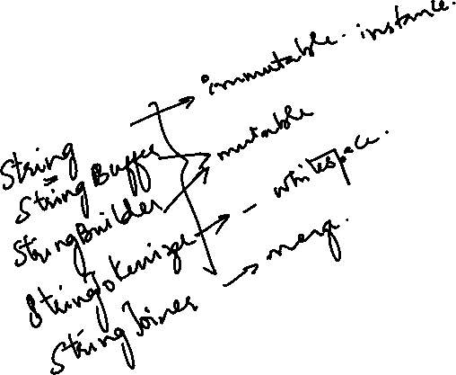
IMP Note to Self

Slide 3
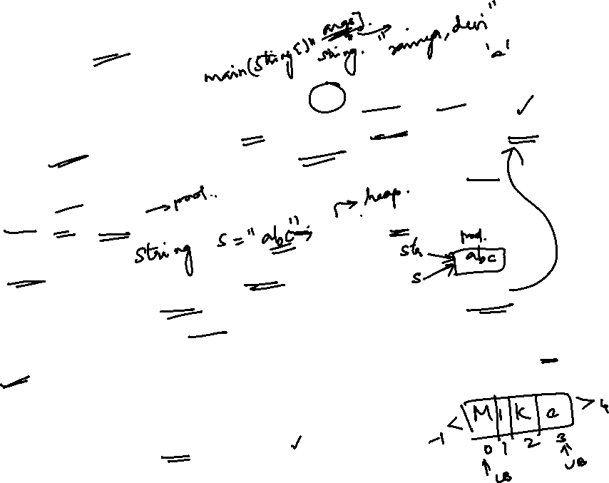
String Introduction
Represents character strings such as “a”, “David”, “Mike” etc
Every String literal (such as “123”, “Ram”, “151103” etc.) is a String type object in Java and hence any String class method can be invoked via string type literals also. For Example, “abc”.length(), “abc”.equals(“ABC”);
String str = “abc”; , or String str = new String(“abc”); are equivalent
statements
Strings in Java represents immutable strings
Every string has a length which can be retrieved using length()
method. For Example “Mike”.length() returns 4
Every character of String object is idexed and index varies from 0 to L-1 (Where ‘L’ is length of String). For example, string “Mike” has character ‘M’ at index 0, character ‘i’ at index 1 etc.
Getting characters out of index will results in
StringIndexOutofBoundsException.

Slide 4
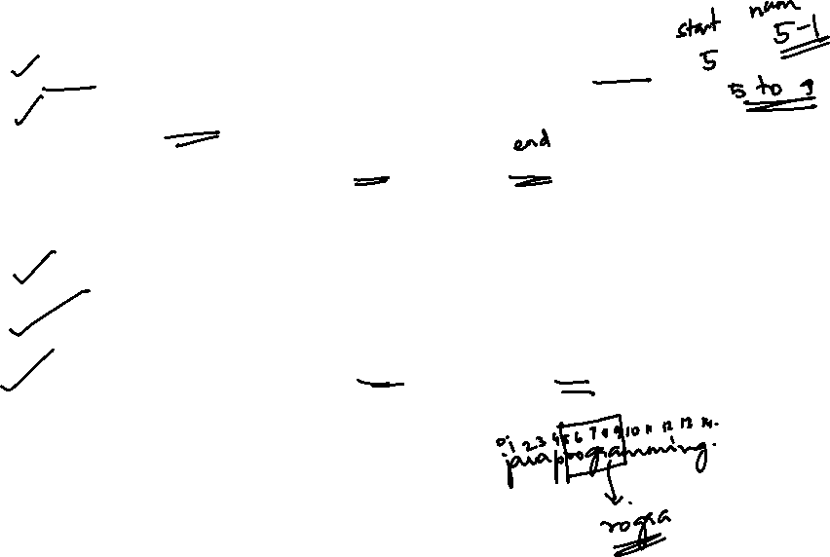
Important String Constructors
String() → Creates an Empty String, length =0
String(char[] str) → Creates a string from char array
String(char chars[],int start, int numChars) → Creates a String from chars array starting from index ‘start’ to ‘start + numChars – 1’
String(String str) → Creates a String from another String
String(byte[] bytes) → Creats a String from byte array
String(byte bytes[],int start, int numChars) → Creats a String from bytes starting from index ‘start’ to ‘start + numChars – 1’

Slide 5
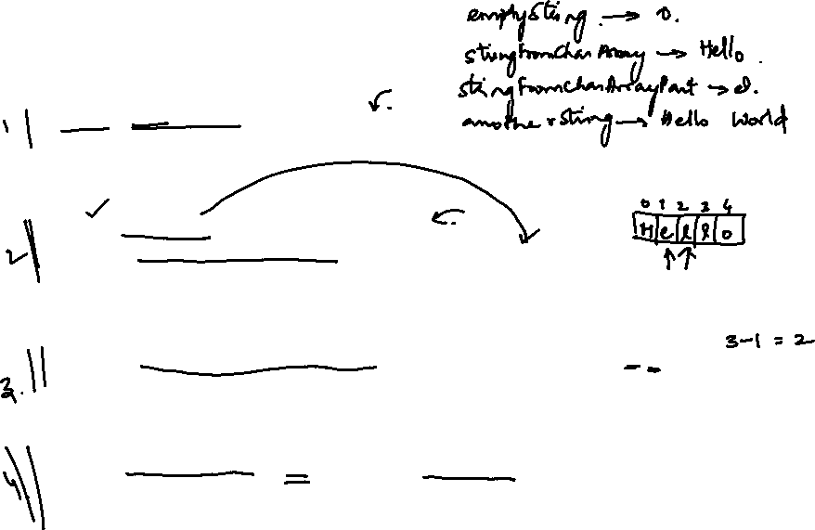
public class Main
{
public static void main(String[] args)
{
String emptyString = new String();
System.out.println("Empty String: \"" + emptyString + "\"");
char[] charArray = {'H', 'e', 'l', 'l', 'o'};
String stringFromCharArray = new String(charArray);
System.out.println("String from char array: " + stringFromCharArray);
String stringFromCharArrayPart = new String(charArray, 1, 3);
System.out.println("String from part of char array: " + stringFromCharArrayPart);
// 4. String(String str) – Creates a string from another string
String anotherString = new String("Hello World");
String stringFromAnotherString = new String(anotherString);
System.out.println("String from another String: " + stringFromAnotherString);

Slide 6


// 5. String(byte[] bytes) – Creates a string from byte array
byte[] byteArray = {72, 101, 108, 108, 111};
String stringFromByteArray = new String(byteArray);
System.out.println("String from byte array: " + stringFromByteArray);
// 6. String(byte bytes[], int start, int numChars) – Creates a string from byte array starting from index 'start' to 'start + numChars - 1'
byte[] byteArrayPart = {72, 101, 108, 108, 111, 87, 111, 114, 108, 100};
String stringFromByteArrayPart = new String(byteArrayPart, 6, 2);
System.out.println("String from part of byte array: " + stringFromByteArrayPart);
}
}

Slide 7

String Constructors: Example
// Creating Strings from String Literals
String str String str1
= "abc"; //
= new String("abc");
String str = new String("abc");
// Creating Strings from char[] Array char[] chs = {'o','b','j','e','c','t'};
String str2 = new String(chs);
// str2:“object"
String str3 = new String(chs,2,4);
// start-index=1, number-of-characters=4,index range: 2 to 5 (“ject”);
//String str4 = new String(chs,3,4);
// start-index=3, number-of-characters=4,index range: 3 to 6
Results in StringIndexOutofBoundsException
// Creating Strings from byte[] Array
byte[] bytes = {45,65,90,78,23,89};
String str5 = new String(bytes); // str5: -AZN↨Y
String str6 = new String(bytes,2,4); // start-index=1, number-of-characters=4,index range: 2 to 5, str6: ZN↨Y
//String str7 = new String(bytes,3,4); // start-index=3, number-of-characters=4,index range: 3 to 6

Slide 8
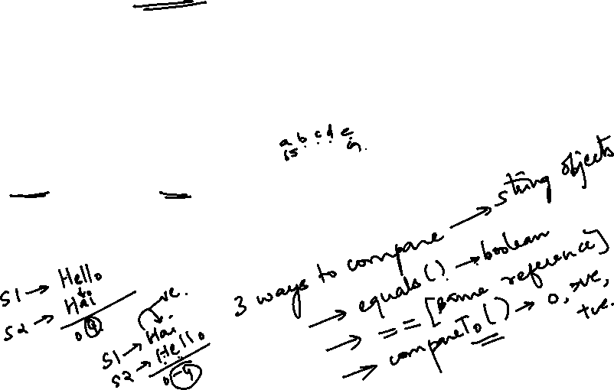
Comparing Strings : equals() Method
public boolean equals(String other) → Returns true if this string is equal to other otherwise false. Two strings are equal if they have same character at each index and their lengths are equal.
equals() → Checks states of two string references
Examples
“abc”.equals(“abc”) returns true
String s1 = “xyz”; String s2 = “abc”; s1.equals(s2) or s2.equals(s1) returns false

Slide 9
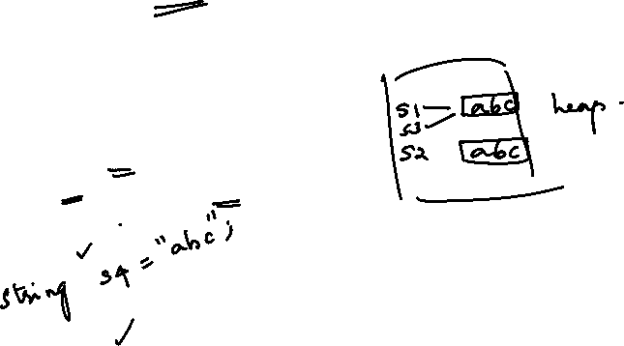
Comparing Strings : equals() Method vs ==
Equality operator (==) returns true if both string references are pointing to same object otherwise false.
equals() method checks the states of the string references
Example:
String String String
s1 = new String(“abc”); s2 = new String(“abc”); s3 = s1;
if(s1 == s2)
else
System.out.println(“Hello”);
System.out.println(“Hi”);
Hi
if(s1.equals(s2)) else
:String
System.out.println(“Hello”); System.out.println(“Hi”);
Hello
:String
s1 s3
abc
s2
abc

Slide 10
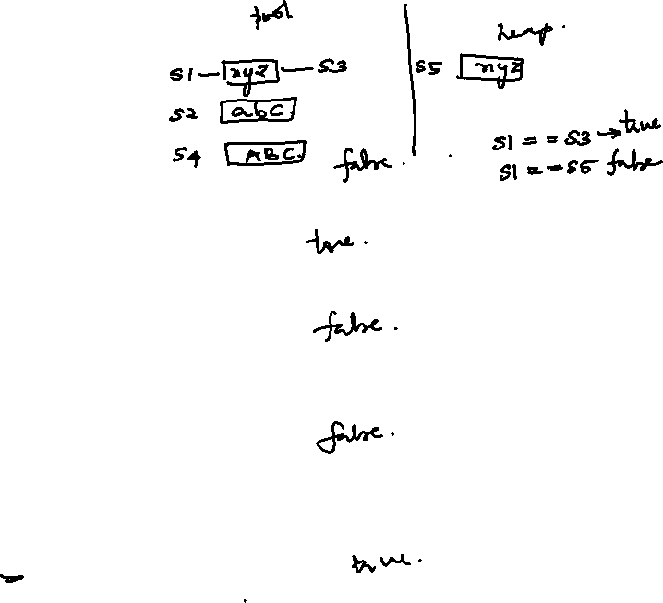
public class Main {
public static void main(String[] args) {
// Create two strings
String s1 = "xyz";
String s2 = "abc";
String s3 = "xyz";
// Compare s1 and s2
System.out.println("s1.equals(s2): " + s1.equals(s2)); // Returns false because "xyz" is not equal to "abc"
// Compare s1 and s3
System.out.println("s1.equals(s3): " + s1.equals(s3)); // Returns true because both are "xyz"
// Compare s2 and s3
System.out.println("s2.equals(s3): " + s2.equals(s3)); // Returns false because "abc" is not equal to "xyz"
// Compare with different case (e.g., "abc" vs "ABC")
String s4 = "ABC";
System.out.println("s2.equals(s4): " + s2.equals(s4)); // Returns false because "abc" is not equal to "ABC"
// Compare strings with the same value but different references
String s5 = new String("xyz");
System.out.println("s1.equals(s5): " + s1.equals(s5)); // Returns true because the content is the same
}
}

Slide 11
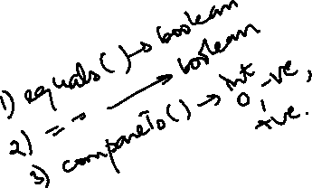
Comparing Strings : equals() Method vs == ….
Example:
String String String
s1 = new String(“abc”); s2 = new String(“abc”); s3 = s1;
if(s1 == s3)
else
System.out.println(“Hello”);
System.out.println(“Hi”);
Hello
:String
:String
s1 s3
abc
abc
s2

Slide 12
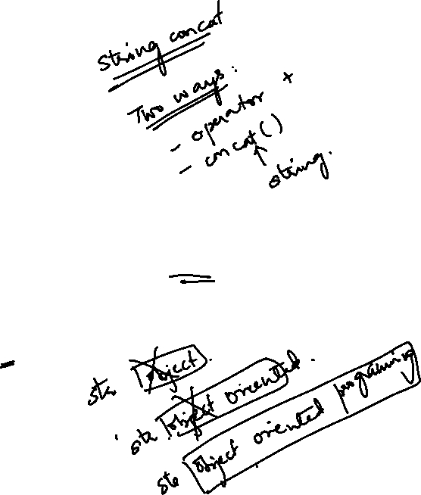
Predict the Output
//File Name: StringDemo.java class StringDemo
{
public static void main(String[] args)
{
String | str | = | new | String("Object");
str |  | = | str + | " Oriented";
str |  | = | str + | " Programming";
System.out.println(str);
}// End of Method
}// End of class StringDemo

Slide 13
Predict the Output
//File Name: StringDemo.java class StringDemo
{
public static void main(String[] args)
{
String str = new
str = str +
str = str +
System.out.println(str);
:String
String("Object");
str
Object
" Oriented";
" Programming";
}// End of Method
}// End of class StringDemo

Slide 14
Predict the Output
//File Name: StringDemo.java class StringDemo
{
public static void main(String[] args)
{
:String
String | str = | new | String("Object");
str | = | str + | " Oriented";
str | = | str + | " Programming";
Object
:String
str
Object Oriented
System.out.println(str);
}// End of Method
}// End of class StringDemo

Slide 15
Predict the Output
//File Name: StringDemo.java class StringDemo
{
public static void main(String[] args)
{
:String
String | str = | new | String("Object");
str | = | str + | " Oriented";
str | = | str + | " Programming";
Object
:String
Object Oriented
Garbage Objects
System.out.println(str);
:String
}// End of Method
}// End of class StringDemo
str
Object Oriented Programming
Object Oriented Programming
Each Time You Update a string reference via + operator , A new String Object is Created with updated Contents

Slide 16
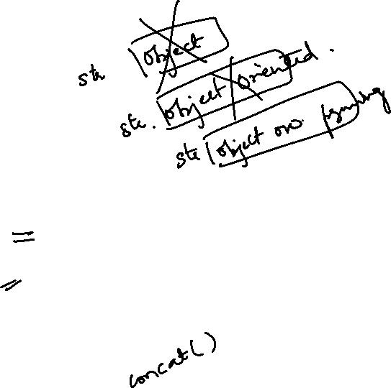
Predict the Output
//File Name: StringDemo.java class StringDemo
{
public static void main(String[] args)
{
String | str | = | new String("Object");
str | = | new | String(“Object Oriented”);
str | = | new | String(“Object Oriented Programming“);
System.out.println(str);
}// End of Method
}// End of class StringDemo

Slide 17
How Many String Objects are Created?
//File Name: StringDemo.java class StringDemo
{
public static void main(String[] args)
{
String s1 = "abc";
String s2 = "abc";
String s3 = "abc";
String s4 = "abc";
}// End of Method
}// End of class StringDemo

Slide 18
How Many String Objects are Created?
//File Name: StringDemo.java class StringDemo
{
public static void main(String[] args)
{
String s1 = "abc";
String s2 = "abc";
String s3 = "abc";
String s4 = "abc";
}// End of Method
}// End of class StringDemo
String s1 = new String("abc“);
:String
s1
abc

Slide 19
How Many String Objects are Created?
//File Name: StringDemo.java class StringDemo
{
public static void main(String[] args)
{
String s1 = "abc";
String s2 = "abc";
String s3 = "abc";
String s4 = "abc";
}// End of Method
}// End of class StringDemo
String s1 = new String("abc“);
:String
s1
abc
s2

Slide 20
How Many String Objects are Created?
//File Name: StringDemo.java class StringDemo
{
public static void main(String[] args)
{
String s1 = "abc";
String s2 = "abc";
String s3 = "abc";
String s4 = "abc";
}// End of Method
}// End of class StringDemo
String s1 = new String("abc“);
:String
s1
abc
s2
s3

Slide 21
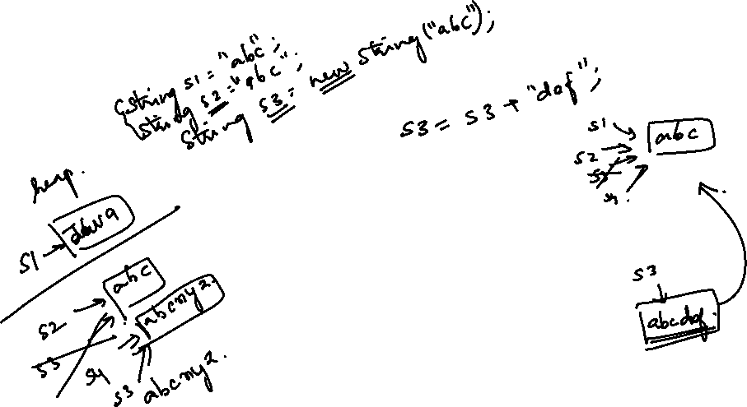
How Many String Objects are Created?
//File Name: StringDemo.java class StringDemo
{
public static void main(String[] args)
{
String s1 = "abc";
String s2 = "abc";
String s3 = "abc";
String s4 = "abc";
}// End of Method
}// End of class StringDemo
String s1 = new String("abc“);
:String
s1
abc
s2
Only One Object is Created in This Example
s3 s4

Slide 22
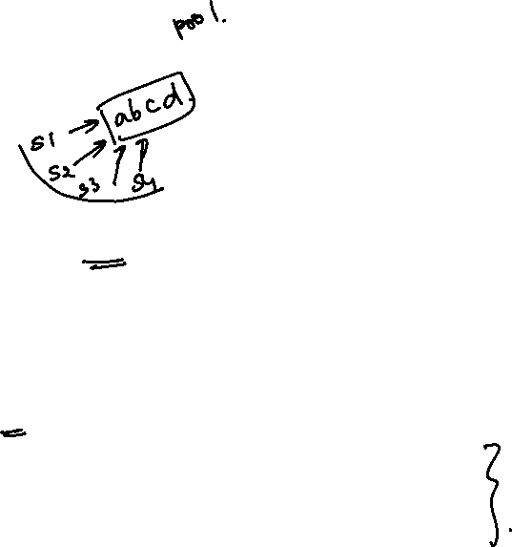
Predict The Output?
//File Name: StringDemo.java class StringDemo
{
public static void main(String[] args)
{
String s1 = "a" + "b" + "c" + "d";
String s2 = "ab" + "cd"; String s3 = "abc" + "d";
String s4 = "a" + "bc" + "d";
<<OUTPUT>>
F:\>java StringDemo Hello
Hello Hello
if(s1 == s2) else
System.out.println("Hello"); System.out.println("Hi");
if(s2 == s3)
else
System.out.println("Hello");
System.out.println("Hi");
if(s3 == s4) else
System.out.println("Hello"); System.out.println("Hi");
}// End of Method
}// End of class StringDemo

Slide 23
Important String Methods

Slide 24
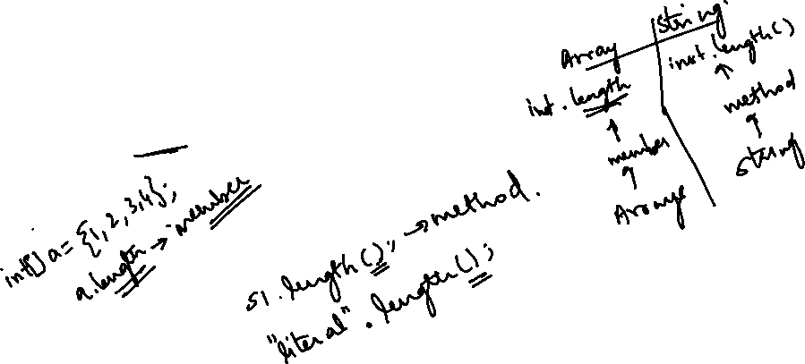
Getting length of Strings
int length() → Returns the length of this String
reference
Example
“abc”.length() returns 3
String s1 =“Object”; s1.length() returns 6

Slide 25
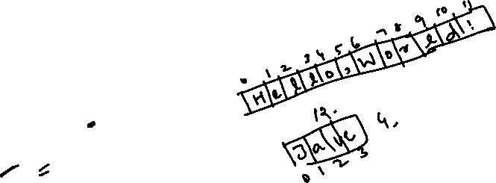
public class Main {
public static void main(String[] args) {
// Create strings of different lengths
String s1 = "Hello,World!";
String s2 = "Java";
String s3 = "";
// Get the length of each string
int length1 = s1.length(); // Length of "Hello, World!" is 12
int length2 = s2.length(); // Length of "Java" is 4
int length3 = s3.length(); // Length of an empty string is 0
// Print the lengths
System.out.println("Length of s1: " + length1); // Output: 12
System.out.println("Length of s2: " + length2); // Output: 4
System.out.println("Length of s3: " + length3); // Output: 0
}
}

Slide 26
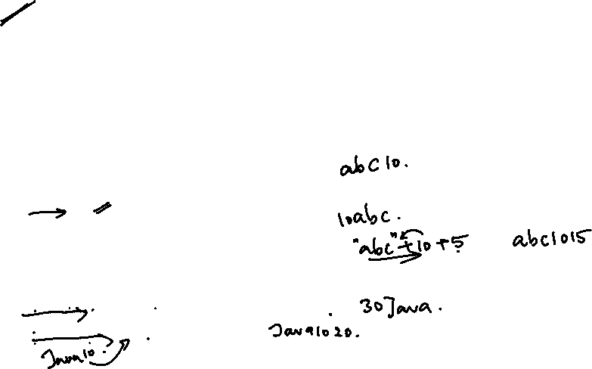
String Concatenation Using ‘+’ operator
• + operator can be used for string concatenation
• + operator can concatenate not only two strings but also a string type value with any other type
Suppose ‘s’ is String reference and ‘t’ is any type other than string. Then an expression ‘s + t’ will convert t to string type and final result will be of String type
Examples
“abc” + 10 → results in “abc10”
10 + “abc” → results in “10abc”
“abc” + “def” → results in “abcdef”
4.56 + “Object” → results in “4.56Object”
10 + 20 + “Java” → results in 30Java
6. “Java”+10+20 → Java1020

Slide 27

String Concatenation Using ‘concat()’ Method
String concat(String s) → Appends ‘s’ with this String and
returns a new String with updated contents
However, preferred way for string concatenation is via ‘+’ operator
Examples
String s1 = “Object”;
String s2 = s1.concat(“-Oriented Programming);
System.out.println(“Java ”.concat(“ World”));

Slide 28
Character Extraction : chartAt()
char chartAt(int index) → Returns the character at index. The value of
index should be 0<=index<=L-1, where ‘L’ is length of string.
Examples:
“abc”.charAt(0) → returns ‘a’
“abc”.charAt(3) → results in StringIndexOutofBoundsException
String s1 = “Object-Oriented Programming”; s1.charAt(10) → returns ‘e’

Slide 29
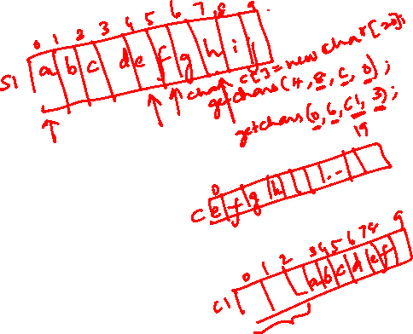
Character Extraction : getChars()
void getChars(int sourceStart, int sourceEnd, char target[], int targetStart)
Charcaters are extracted from invoking (this) string reference
sourceStart → start index of invoking (this) string reference from where character
extraction will start (0 <= sourceStart <= L-1, where L is length of invoking string)
sourceEnd→ end index (exclusive) of invoking (this) string reference. (0 <= sourceEnd
<= L-1, where L is length of invoking string and also sourceStart<=sourceEnd)
Characters are extracted from sourceStart to sourceEnd-1
target represents the target character array where extracted characters will be stored
targetStart → start index of target from where characters will be stored. Note: target
array should be large enough to store the extracted characters.

Slide 30
Character Extraction : getChars() : Example 1
//File Name: StringDemo.java class StringDemo
{
public static void main(String[] args)
{
String | s | = "When Java converts data";
char[] | chars | = new char[100];
s.getChars(10,30,chars,0);
System.out.println(chars);
}// End of Method
}// End of class StringDemo
Start index =10 End index = 29
F:\>java StringDemo
Exception in thread "main" java.lang.StringIndexOutOfBoundsException: String ind ex out of range: 30
at java.lang.String.getChars(Unknown Source) at StringDemo.main(xyz.java:8)

Slide 31
Character Extraction : getChars() : Example 2
//File Name: StringDemo.java class StringDemo
{
public static void main(String[] args)
{
String | s | = "When Java converts data";
char[] | chars | = new char[100];
s.getChars(10, 5 ,chars,0);
System.out.println(chars);
}// End of Method
}// End of class StringDemo
endIndex < startIndex
F:\>java StringDemo
Exception in thread "main" java.lang.StringIndexOutOfBoundsException: String ind ex out of range: -5
at java.lang.String.getChars(Unknown Source) at StringDemo.main(xyz.java:8)

Slide 32
Character Extraction : getChars() : Example 3
Characters will be extracted from index 4 to 13 (10 characters)
//File Name: StringDemo.java class StringDemo
{
public static void main(String[] args)
{
String s = "When Java converts data";
char[] chars = new char[20]; s.getChars(4, 14 ,chars,14);
System.out.println(chars);
}// End of Method
}// End of class StringDemo
To store 10 chacters from index 14 the last index should be 23
However the last index of chars is 19
F:\>java StringDemo
Exception in thread "main" java.lang.ArrayIndexOutOfBoundsException at java.lang.System.arraycopy(Native Method)
at java.lang.String.getChars(Unknown Source) at StringDemo.main(xyz.java:8)

Slide 33
Character Extraction : getChars() : Example 4
Characters will be extracted from index 4 to 13 (10 characters)
//File Name: StringDemo.java class StringDemo
{
public static void main(String[] args)
{
String s = "When Java converts data";
char[] chars = new char[20]; s.getChars(4, 14 ,chars,4);
System.out.println(chars);
}// End of Method
}// End of class StringDemo
<<OUTPUT>>
F:\>java StringDemo Java conv

Slide 34
byte[] getBytes() : Method
byte[] getBytes() → Converts each character of string to
byte and returns a byte arrays
Example
1. byte[] values = for(int i =0; i < values.length; i++)
System.out.print(values[i] + “ “);
“Object”.getBytes();
79 98 106 101 99 116
2. byte[] | bytes | = | new byte[10];
String | s1 | = | “Java”;
bytes |  | = | s1.getBytes();
for(int i =0; i < bytes.length; i++)
System.out.print(bytes[i] + “ “);
74 97 118 97

Slide 35
char[ ] toCharArray()
char[ ] toCharArray() → converts a string into a char type
array and returns char[]
//File Name: StringDemo.java class StringDemo
{
public static void main(String[] args)
{
System.out.println("Thomas Alva Edison".length()); char[] name = "Thomas Alva Edison".toCharArray();
System.out.println(name.length); System.out.println(name);
}// End of Method
}// End of class StringDemo
F:\>java StringDemo 18
18
Thomas Alva Edison

Slide 36
String Comparisons: equals() and equalsIgnoreCase()
boolean equals(String other) → case-sensitive
comparison [upper and lower-case letters are not equal]
Example : “abc”.equals(“Abc”) returns false, “abc”.equals(“abc”) returns true
boolean equalsIgnoreCase(String other) → Comparison by ignoring the case of characters
Example : “abc”.equalsIgnoreCase (“ABC”) or “aBc”.
equalsIgnoreCase (“abC”) returns true

Slide 37

String Comparisons: regionMatches()
regionMatches() → compares the regions of two string references for equality [returns true if regions matches otherwise false]
Syntax:
boolean regionMatches(int startIndex, String str2, int str2startIndex, int numChars) → case-sensitive comparison
1.
Number of characters to be
compared
[str2startIndex to str2startIndex + numChars – 1]
start index of
invoking string
Second String
for comparison
start index of
second String
2.
boolean regionMatches(boolean ignoreCase, int startIndex, String str2, int str2startIndex, int numChars) → Can ignore case if the first parameter value is true.
Note :
Index parameters should be within range otherwise
StringIndexOutofBoundsException will be thrown

Slide 38
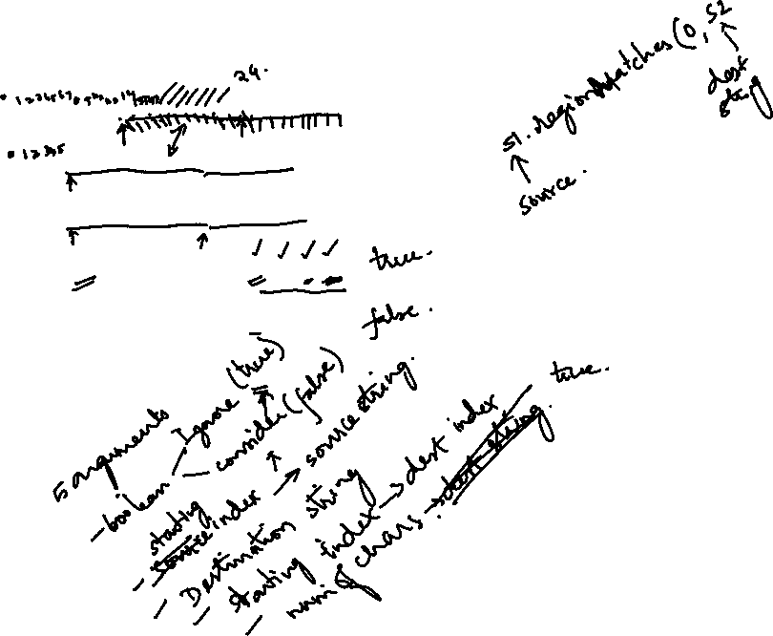
String Comparisons: regionMatches() : Example
String s1 = "India finally has started preparations for Rio Olympics";
String s2 = "David has started preparations for Final Exams";
String s3 = "David has Started PREPARATIONS FOR Final Exams";
System.out.println(s1.regionMatches(14,s2,6,24)); // Case-Sensitive System.out.println(s1.regionMatches(14,s3,6,24)); // Case-Sensitive System.out.println(s1.regionMatches(true,14,s3,6,24)); // Ignore-case
System.out.println(s1.regionMatches(false,14,s3,6,24)); // Case-Sensitive
true
false
true
false

Slide 39

String Comparisons: startsWith() and endsWith()
boolean startsWith(String str) → Returns true if this string starts with ‘str’ otherwise false. For Example, “Object”startsWith(“Obj”) returns true.
boolean startsWith(String str, int startIndex) → Overloaded Flavor. Returns true if this string starts with ‘str’ from index startIndex otherwise false. For Example, “Object”startsWith(“ect”,3) returns true.
boolean endsWith(String str) → Returns true if this string ends with ‘str’ otherwise false. For Example, “FooBar”.endsWith(“Bar”); returns true

Slide 40
String Comparisons: compareTo()
int compareTo(String str) → Case-Sensitive Comparison. returns a +ive value if this string is > str , -ive value if this string is < str, otherwise a 0 (zero) value. Used For sorting an arrays of String values.
Comparison is done character by character. If all characters of both strings matches then 0 is returned otherwise a difference of the first non- matched character is returned
Examples
System.out.println("Ram".compareTo("RAM")); // Prints 32
System.out.println("Java".compareTo("Object")); // Prints -5
System.out.println("Hello".compareTo("Welcome")); // Prints -15
int compareToIgnoreCase(String str) → Ignore case comparison.
Examples
System.out.println("Ram".compareToIgnoreCase("RAM")); // Prints
0
System.out.println(“oBjeCt”.compareTo(“OBJECT")); // Prints 0

Slide 41
Important String Methods
Searching Strings [indexOf() and lastIndexOf()]
Modifying a String [substring(), replace() and trim()]
Data Conversion [valueOf()]
Changing Case of Characters [toUpperCase() and toLowerCase()]

Slide 42
Searching Strings : indexOf() and lastIndexOf()
int indexOf(int ch) → Searches the index of character ‘ch’ in this string and returns that
index value (if found) otherwise returns -1 (if not found)
int lastIndexOf(int ch) → Searches the last index of character ‘ch’ in this string and returns that index value (if found) otherwise returns -1 (if not found)
int indexOf(String str) → Searches the index of string “str” in this string and returns that index value (if found) otherwise returns -1 (if not found)
int lastIndexOf(String str) → Searches the last index of string “str” in this string and
returns that index value (if found) otherwise returns -1 (if not found)
int indexOf(int ch, int startIndex) → Searches the index of charcter ‘ch’ in this string starting from startIndex and returns that index value (if found) otherwise returns -1 (if not found)
int lastIndexOf(int ch, int startIndex) → Searches the last index of character ‘ch’ in this string starting from startIndex and returns that index value (if found) otherwise returns -1 (if not found)
int indexOf(String str, int startIndex) → Searches the index of string “str” in this string starting from startIndex and returns that index value (if found) otherwise returns -1 (if not found)
int lastIndexOf(String str, int startIndex) → Searches the last index of string “str” in this string starting from startIndex and returns that index value (if found) otherwise returns -1 (if not found)

Slide 43
Searching Strings : indexOf() and lastIndexOf() : Example
String | s | = | "Now is the Time For All Indian";
 | s | = | s + "to come to the aid of India";
System.out.println(s.indexOf("x")); | -1
System.out.println(s.indexOf("a")); | 28
System.out.println(s.lastIndexOf("a")); |  | 56
System.out.println(s.indexOf("Ind")); |  | 24
System.out.println(s.lastIndexOf("Ind")); |  | 52
System.out.println(s.indexOf("Ind",30)); |  | 52

Slide 44
Modifying Strings : substring()
String substring(int startIndex) → Returns a substring starting from stratIndex (inclusive) to the last of this string [Note: 0<=startIndex<=L, where L is length of this String]
String substring(int startIndex, int endIndex) → Returns a substring starting from stratIndex (inclusive) to the endIndex (exclusive) of this string. Returned substring will have characters from startIndex to endIndex-1 [Note: 0<=startIndex,endIndex<=L, where L is length of this String and startIndex <= endIndex]
If values of startIndex and endIndex are equal, then no character will
be extracted
If value of startIndex < endIndex OR startIndex, endIndex > L o, then StringIndexOutOfBoundsException will be thrown

Slide 45
Modifying Strings : substring() Example
String s = "Now is the Time For All Indian";
System.out.println(s.length());
30
<<No Character Will be
extracted
<<No Character
System.out.println(s.substring(30,30));
System.out.println(s.substring(20,20));
Will
extracted
No
be
System.out.println(s.substring(0,2));
System.out.println(s.substring(11));
Time For All Indian

Slide 46
Replacing Characters in String
String replace(char original, char replacement) → Replaces all occurrences of a character original in this String with a character replacement and returns the modified String
Example :
Programming".replace('m','x'))
Prograxxing” as output
System.out.println("Object-Oriented
will result in “Object-Oriented
String trim() → Removes the leading and trailing white spaces from the invoking string and returns the modified String
Example
System.out.println(" My Name is David ".length()); System.out.println(" My Name is David ".trim()); System.out.println(" My Name is David ".trim().length());
20
My Name is David
16

Slide 47
Changing the Case of Characters
String toUpperCase() → Changes each character of the
invoking string to upper case and returns the modified string
String toLowerCase() → Changes each character of the invoking string to lower case and returns the modified string
For Example, the statement System.out.println("My Name is David".toUpperCase()); displays “MY NAME IS DAVID” over console
For Example, the statement System.out.println("My Name is David".toLowerCase()); displays “my name is david” over console

Slide 48
STRING CLASS
2. Using the new Keyword
We can create a String object like any other object as
String S = new String(“Welcome”);
Java String Methods
Here are the list of the methods available in the Java String
class.
char charAt(int index): It returns the character at the specified index.
Specified index value should be between 0 to length() -1 both inclusive.
It throws IndexOutOfBoundsException if index<0||>= length of String.

Slide 49
STRING CLASS
2. boolean equals(Object obj): Compares the string with the specified string and returns true if both matches else false.
3. boolean equalsIgnoreCase(String string): It works same as equals method but it doesn’t consider the case while comparing strings. It does a case insensitive comparison.
4. int compareTo(String string): This method compares the two strings based on the Unicode value of each character in the strings.
5. int compareToIgnoreCase(String string): Same as CompareTo method however it ignores the case during comparison.

Slide 50
STRING CLASS
6. boolean startsWith(String prefix, int offset): It checks whether the substring (starting from the specified offset index) is having the specified prefix or not.
7. boolean startsWith(String prefix): It tests whether the string is having specified prefix, if yes then it returns true else false.
8. boolean endsWith(String suffix): Checks whether the string ends with the specified suffix.
9. int indexOf(int ch): Returns the index of first occurrence of the specified character ch in the string.
10. int indexOf(int ch, int fromIndex): Same as indexOf method however it starts searching in the string from the specified fromIndex.

Slide 51
STRING CLASS
11. int lastIndexOf(int ch): It returns the last occurrence of the character ch in the string.
String substring(int beginIndex): It returns the substring of
the string. The substring starts with the character at the
specified index.
13.String substring(int beginIndex, int endIndex): Returns the substring.
The substring starts with character at beginIndex and ends with the character at endIndex.
14. String concat(String str): Concatenates the specified string “str” at the end of the string.
15.String replace(char oldChar, char newChar): It returns the new updated string after changing all the occurrences of oldChar with the newChar.

Slide 52
STRING CLASS
16. String toLowerCase(): Equivalent to toLowerCase(Locale. getDefault()).
17. String trim(): Returns the substring after omitting leading and trailing white spaces from the original string.
18. char[] toCharArray(): Converts the string to a character array.
19. void getChars(int srcBegin, int srcEnd, char[] dest, int destBegin):
It copies the characters of src array to the dest array.
Only the specified range is being copied(srcBegin to srcEnd) to the dest subarray(starting fromdestBegin).

Slide 53
STRING BUFFER CLASS
Strings in Java are a sequence of characters which is immutable.
Java provides the StringBuffer class to create a mutable String.
Creating StringBuffer Using Constructors
(a) Empty StringBuffer
An empty string buffer with an initial capacity of 16 characters
is created.
Syntax:
StringBuffer S=new StringBuffer();

Slide 54
STRING BUFFER CLASS
(b) StringBuffer with arguments
The string buffer created is of the size specified in the
argument.
StringBuffer S=new StringBuffer(20);// int argument
(c) Str StringBuffer
The argument specified sets the initial contents of the StringBuffer object and reserves space for 16 more characters without reallocation.
StringBuffer S=new StringBuffer(“Java”);//String argument

Slide 55
STRING BUFFER CLASS
Methods in StringBuffer
The methods used in StringBuffer are specified as follows:
1. length()
It specifies the number of elements present.
2. capacity():
The capacity of the StringBuffer can be found using this method.
3. append():
The method is used to add elements at the end of the StringBuffer.
4. insert():
The method is used to insert an element at the specified index
position.

Slide 56
STRING BUFFER CLASS
5. delete(int startIndex, int endIndex)
The method is used to delete the elements present in the
StringBuffer.
The first character to be removed is specified by
the first index.
The elements between the startIndex and endIndex-1 are deleted.
6. deleteCharAt(int index)
The method removes a single character within the string
present in the StringBuffer.
The int index specifies the location of the character.

Slide 57
STRING BUFFER CLASS
7. replace()
The method is used to replace a set of elements or characters
with another, inside the StringBuffer.
The arguments startIndex and endIndex are present in this method.
The substring from the startIndex till the endIndex -1 is replaced.
8.String toString()
This inbuilt method outputs a string representing the data
present in the StringBuffer.
A new String object is declared and initialized to get the character sequence from the StringBuffer object.
The string is then returned by toString().

Slide 58
Packages
Java API packages
User defined package
Accessing classes in packages
Example programs
58

Slide 59
Packages
A java package is a group of similar types of classes, interfaces and sub-packages.
Think of it as a folder in a file directory.
Packages are used to avoid name conflicts, and to write a better maintainable code.
package ←→ directory (folder)
class ←→ file
59

Slide 60

Packages and directories
A class named D in package a.b.c should reside in this file:
a/b/c/D.class
(relative to the root of your project)
The "root" directory of the package hierarchy is determined by your class path or the directory from which java was run.

Slide 61
Packages
Provides a mechanism for grouping a variety of classes and / or interfaces together.
Grouping is based on functionality.
Benefits:
Java package is used to categorize the classes and interfaces so that they can be easily maintained.
Java package provides access protection.
Java package removes naming collision.
61

Slide 62
Packages
Package in java can be categorized in two form, built-in package and user-defined package.
Two types of packages:
Built-in packages
User defined packages
Java API Packages:
A large number of classes grouped into different packages based on functionality. Examples:
1. java.lang
2. java.util
3. java.io
4. java.awt
5. java.net
6. java. applet etc.
62

Slide 63
Package
Java
Package containing awt package
awt
Color
Package containing classes
Graphics
Image
63

Slide 64
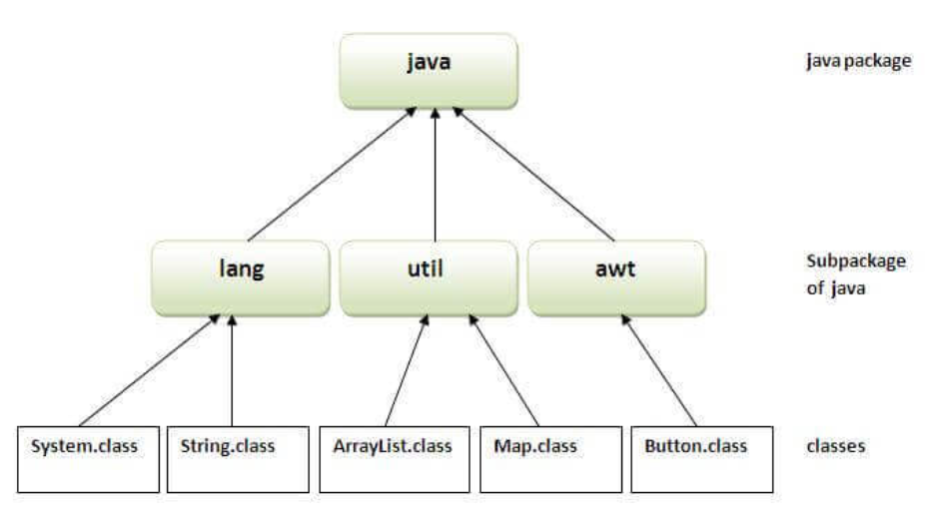
Packages
64

Slide 65
Creating Your Own Package
Declare the package at the beginning of a file using the form
package packagename;
2. Define the class that is to be put in the package and declare it public(optional)
Create a subdirectory under the directory where the main source files are stored
(or javac – d . File.java)
Store the listing as classname.java in the subdirectory created.
Compile the file. From subdirectory.
Example:
package mypack;
public class Simple
{
//Body of the class
}
To Compile: javac -d . Simple.java
To Run: java mypack.Simple
65

Slide 66
Accessing Classes in a Package
There are three ways to access the package from outside the package.
import package.*;
import package.classname;
fully qualified name
66

Slide 67
Adding a Class to a Package
Every java source file can contain only class declared as public.
The name of the source file should be same as the name of the public class with .java extension.
package p1;
public ClassA{ ……………}
Source file : ClassA.java
Subdirectory: p1
package p1;
public ClassB{…………}
Source file: ClassB.java
Subdirectory:p1
67

Slide 68
Example1-Package
import p1.ClassA;
class testclass
{
public static void main(String s[])
{
ClassA obA=new ClassA();
obA.displayA();
}
}
package p1;
public class ClassA
{
public void displayA( )
{
System.out.println(“Class A”);
}
}
Source file – ClassA.java
Subdirectory-p1
ClassA.Java and ClassA.class->p1
Source file-testclass.java
testclass.java and testclass.class->in a directory of which p1 is subdirectory.
68

Slide 69
Creating Packages
Consider the following declaration:
package firstPackage.secondPackage;
This package is stored in subdirectory named firstPackage.secondPackage.
A java package can’t contain more than one class definitions that can be declared as public.
Only one of the classes which is declared public and that class name with .java extension is the source file name.
69

Slide 70
Example2-Package
package p2;
public class ClassB
{
protected int m =10;
public void displayB()
{
System.out.println(“Class B”);
System.out.println(“m= “+m);
}
}
import p1.ClassA;
import p2.ClassB;
class PackageTest2
{
public static void main(String str[])
{
ClassA obA=new ClassA();
Classb obB=new ClassB();
obA.displayA();
obB.displayB();
}
}
70

Slide 71
Example 3- Package
import p2.ClassB;
class ClassC extends ClassB
{
int n=20;
void displayC()
{
System.out.println(“Class C”);
System.out.println(“m= “+m);
System.out.println(“n= “+n);
}
}
class PackageTest3
{
public static void main(String args[])
{
ClassC obC = new ClassC();
obC.displayB();
obC.displayC();
}
}
71

Slide 72
Package
package p1;
public class Teacher
{………….}
public class Student
{……………..}
In Different files
package p2;
public class Courses
{………..}
public class Student
{………………..}..Different files
import p1.*;
import p2.*;
Student student1; //Error
Correct Code:
import p1.*;
import p2.*;
p1.Student student1;
p2.Student student2;
72

Slide 73
Default Package
If a source file does not begin with the package statement, the classes contained in the source file reside in the default package
The java compiler automatically looks in the default package to find classes.
73

Slide 74
Finding Packages
Two ways:
By default, java runtime system uses current directory as starting point and search all the subdirectories for the package.
Specify a directory path using CLASSPATH environmental variable.
74

Slide 75
CLASSPATH Environment Variable
The compiler and runtime interpreter know how to find standard packages such as java.lang and java.util
The CLASSPATH environment variable is used to direct the compiler and interpreter to where programmer defined imported packages can be found
The CLASSPATH environment variable is an ordered list of directories and files
75

Slide 76
CLASSPATH Environment Variable
To set the CLASSPATH variable we use the following command:
set CLASSPATH=c:\
Java compiler and interpreter searches the user defined packages from the above directory.
To clear the previous setting we use:
set CLASSPATH=
76

Slide 77
Example1-Package[Using CLASSPATH]
package p1;
public class ClassA
{
public void displayA( )
{
System.out.println(“Class A”);
}
}
import p1.ClassA;
Class PackageTest1
{
public static void main(String str[])
{
ClassA obA=new ClassA();
obA.displayA();
}}
Source file – c:\p1\ClassA.java
Compile-javac c:\p1\ClassA.java
Class file in –c:\p1\ClassA.class
Source file-c:\java\jdk1.6.0_06\bin\PackageTest1.java
Compile-javac PackageTest1.java
Copy –PackageTest1.class -> c:\
Execute-java PackageTest1
77

Slide 78
Example2-Package[Using CLASSPATH]
package p2;
public class ClassB
{
protected int m =10;
public void displayB()
{
System.out.println(“Class B”);
System.out.println(“m= “+m);
}
}
import p1.*;
import p2.*;
class PackageTest2
{
public static void main(String str[])
{
ClassA obA=new ClassA();
Classb obB=new ClassB();
obA.displayA();
obB.displayB();
} }
Source file – c:\p2\ClassB.java
Compile-c:\p2\ClassB.java
Class file in –c:\p2\ClassB.class
Source file-c:\java\jdk1.6.0_06\bin\PackageTest2.java
Compile-javac PackageTest2.java
Copy –PackageTest2.class -> c:\
Execute-java PackageTest2

Slide 79
Example 3- Package[Using CLASSPATH]
import p2.ClassB;
class ClassC extends ClassB
{
int n=20;
void displayC()
{
System.out.println(“Class C”);
System.out.println(“m= “+m);
System.out.println(“n= “+n);
}
}
class PackageTest3
{
public static void main(String args[])
{
ClassC obC = new ClassC();
obC.displayB();
obC.displayC();
}
}
Source file-c:\java\jdk1.6.0_06\bin\PackageTest3.java
Compile-javac PackageTest3.java
Copy –PackageTest3.class -> c:\
Execute-java PackageTest3
Source file – c:\ClassC.java
Compile-c:\ClassC.java
Class file in –c:\ClassC.class
79

Slide 80
Adding a Class to a Package
Every java source file can contain only class declared as public.
The name of the source file should be same as the name of the public class with .java extension.
package p1;
public ClassA{ ……………}
Source file : ClassA.java
Subdirectory: p1
package p1;
public ClassB{…………}
Source file: ClassB.java
Subdirectory:p1
80

Slide 81
Adding a Class to a Package
Decide the name of the package.
Create the subdirectory with this name under the directory where the main source file is located.
Create classes to be placed in the package in separate source files and declare the package statement
package packagename;
4. Compile each source file. When completed the package will contain .class files of the source files.
81

Slide 82
public/package/private scope
Scope is concerned with the visibility of program elements such as classes and members
Class members (methods or instance fields) can be defined with public, package (default), private or protected scope
A class has two levels of visibility:
-public scope means it is visible outside its containing package
- default scope means it is visible only inside the package. (package scope/ friendly scope)
82

Slide 83
public/package/private scope
A class member with public scope means it is visible anywhere its class is visible
A class member with private scope means it is visible only within its encapsulating class
A class/class member with package scope means it is visible only inside its containing package
A class member with protected scope means it is visible every where except the non-subclasses in other package.
83

Slide 84
Example 1
package my_package;
class A // package scope
{
// A’s public & private members
}
public class B // public scope
{
// B’s public and private members
}
84

Slide 85
Example-2
package my_package;
class D
{
// D’s public & private members
// Class D ‘knows’ about classes A and B
private B b; // OK – class B has public scope
private A a; // OK – class A has package scope
}
85

Slide 86
Example-3
package another_package;
import my_package.*;
class C
{
// C’s public & private members
// class C ‘knows’ about class B
private B b; // OK – class B has public scope
}
86

Slide 87
Example 4
package my_package;
class A
{
int get() { return data; } // package scope
public A(int d) { data=d;} // public scope
private int data; // private scope
}
class B
{
void f()
{
A a=new A(d); // OK A has package scope
int d=a.get(); // OK – get() has package scope
int d1=a.data; // Error! – data is private
}}
87

Slide 88
Levels of Access Control
 | public | protected | friendly (default) | private
same class | Yes | Yes | Yes | Yes
Subclass in the same package | Yes | Yes | Yes | No
Other class in the same package | Yes | Yes | Yes | No
Subclass in other packages | Yes | Yes | No | No
Non-subclass in other package | Yes | No | No | No
88

Slide 89
Method Overriding

Slide 90
Overriding method
The benefit of overriding is ability to define a behavior that's specific to the subclass type, which means a subclass can implement a parent class method based on its requirement.
In object-oriented terms, overriding means to override the functionality of an existing method.

Slide 91
Example 1
class Animal {
public void move() {
System.out.println("Animals can move");
}
}
class Dog extends Animal {
public void move() {
System.out.println("Dogs can walk and run");
}
}
public class TestDog {
public static void main(String args[]) {
Animal a = new Animal(); // Animal reference and object
Animal b = new Dog(); // Animal reference but Dog object
a.move(); // runs the method in Animal class
b.move(); // runs the method in Dog class
}
}
Output:
Animals can move
Dogs can walk and run

Slide 92
Example 2
class Animal {
public void move() {
System.out.println("Animals can move");
}}
class Dog extends Animal {
public void move() {
System.out.println("Dogs can walk and run");
}
public void bark() {
System.out.println("Dogs can bark");
}}
public class TestDog {
public static void main(String args[]) {
Animal a = new Animal(); // Animal reference and object
Animal b = new Dog(); // Animal reference but Dog object
a.move(); // runs the method in Animal class
b.move(); // runs the method in Dog class
b.bark();
}}
Output:
TestDog.java:26: error: cannot find symbol
b.bark();
^
symbol: method bark()
location: variable b of type Animal
1 error

Slide 93
Rules for Method Overriding
The argument list should be exactly the same as that of the overridden method.
The return type should be the same or a subtype of the return type declared in the original overridden method in the superclass.
The access level cannot be more restrictive than the overridden method's access level. For example: If the superclass method is declared public then the overridding method in the sub class cannot be either private or protected.
Instance methods can be overridden only if they are inherited by the subclass.
A method declared final cannot be overridden.
A method declared static cannot be overridden but can be re-declared.

Slide 94
Rules for Method Overriding
If a method cannot be inherited, then it cannot be overridden.
A subclass within the same package as the instance's superclass can override any superclass method that is not declared private or final.
A subclass in a different package can only override the non-final methods declared public or protected.
An overriding method can throw any uncheck exceptions, regardless of whether the overridden method throws exceptions or not. However, the overriding method should not throw checked exceptions that are new or broader than the ones declared by the overridden method. The overriding method can throw narrower or fewer exceptions than the overridden method.
Constructors cannot be overridden.

Slide 95
Example 1 – using super keyword
class Animal {
public void move() {
System.out.println("Animals can move");
}
}
class Dog extends Animal {
public void move() {
super.move(); // invokes the super class method
System.out.println("Dogs can walk and run");
}
}
public class TestDog {
public static void main(String args[]) {
Animal b = new Dog(); // Animal reference but Dog object
b.move(); // runs the method in Dog class
}
}
Output:
Animals can move
Dogs can walk and run

Slide 96
Example 2 – Private method overriding
package a;
public class Hello {
private void printMessage()
{ System.out.println("Hello"); }
public void fun()
{ printMessage(); }
}
package b;
import a.Hello;
public class World extends Hello {
private void printMessage()
{ System.out.println("World"); }
public static void main(String[] args)
{ Hello obj = new World();
obj.fun();
}
}
Note: As private method of parent class is not visible in child class. Thus no overriding takes place here.
Output:
Hello

Slide 97
Example 3 – Public method overriding
package a;
public class Hello {
public void printMessage()
{
System.out.println("Hello");
}}
package b;
import a.Hello;
public class World extends Hello {
public void printMessage()
{
System.out.println("World");
}
public static void main(String[] args)
{
Hello gfg = new World();
gfg.printMessage();
}
}
Output:
World

Slide 98
Example 4 – Default method overriding
package a;
public class Hello {
void printMessage()
{
System.out.println("Hello");
}
}
package b;
import a.Hello;
public class World extends Hello {
void printMessage()
{
System.out.println("World");
}
public static void main(String[] args)
{
Hello gfg = new World();
gfg.printMessage();
}}
Output:
error: printMessage() is not public in Hello; cannot be accessed from outside package

Slide 99
Thank You

